Slide 1




Capstone Design Project
Weekly Progress
Perfect StudyMate
Team k
Juyong Rhee | Yewon Chun | Jihee Hwang | Jorge Alcorta

Slide 2
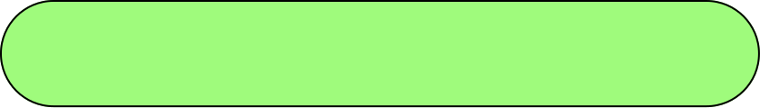

Milestone
 | Week5 | Week6 | Week7 | Week8 | Week9 | Week10 | Week11 | Week12 | Week13
Langchain & RAG Study
AI Structure Design
AI Architecture Development
Database Design
API Specification
API Integration
API Implementation
UI/UX Design
FrontEnd Implementation
Integration Testing
By extending the foundation for AI modeling development,
we considered additional features and tried to improve the model.

Slide 3








Role Division
Juyong Rhee
Yewon Chun
- Team Leader
- BackEnd Development
AI Model Development
Documentation
Jihee Hwang
Jorge Alcorta
UI/UX Designmer
FrontEnd Development
AI Model Development
Presentation

Slide 4
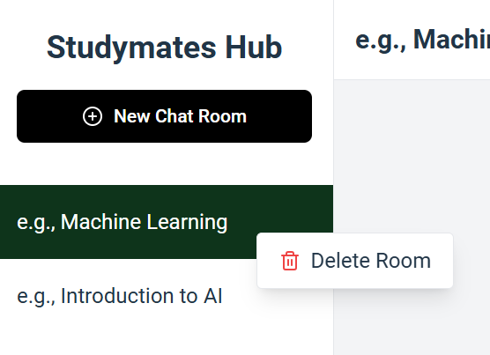

Frontend Development
New features Added | Chatroom Deletion
User can delete the chatroom by right clicking on the title of the chatroom.

Slide 5
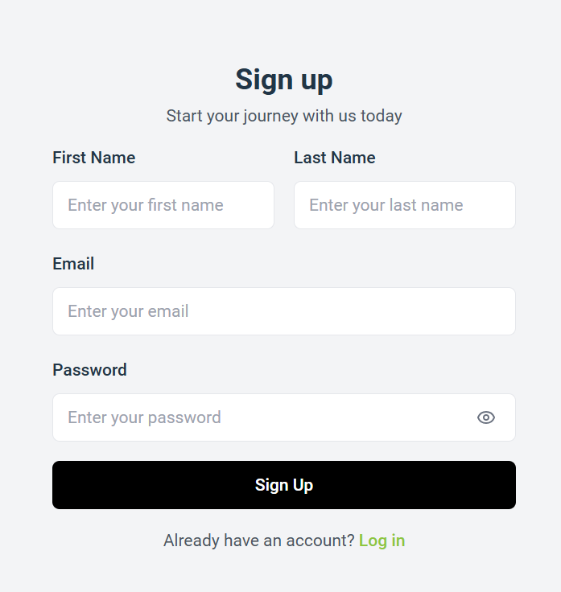

Frontend Development
New features Added | User Sign Up
A screen for users to sign up before using the service.
After that, we plan to implement the login function by linking this screen with user registration API.

Slide 6
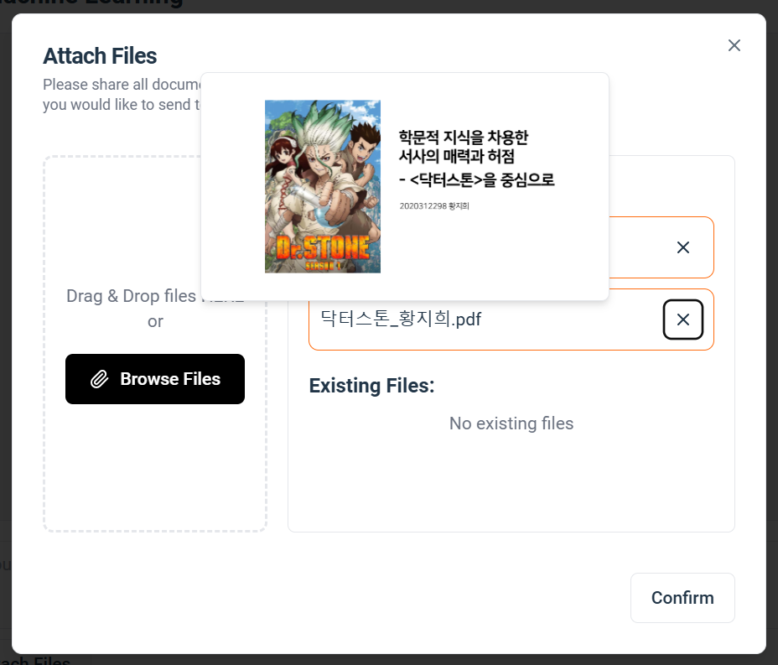

Frontend Development
New features Added | PDF File Preview
preview
If user hover the title of the uploaded document,
user can check the preview pop-up of that document.
User can differentiate new files and existing files
By viewing the preview of documents.

Slide 7
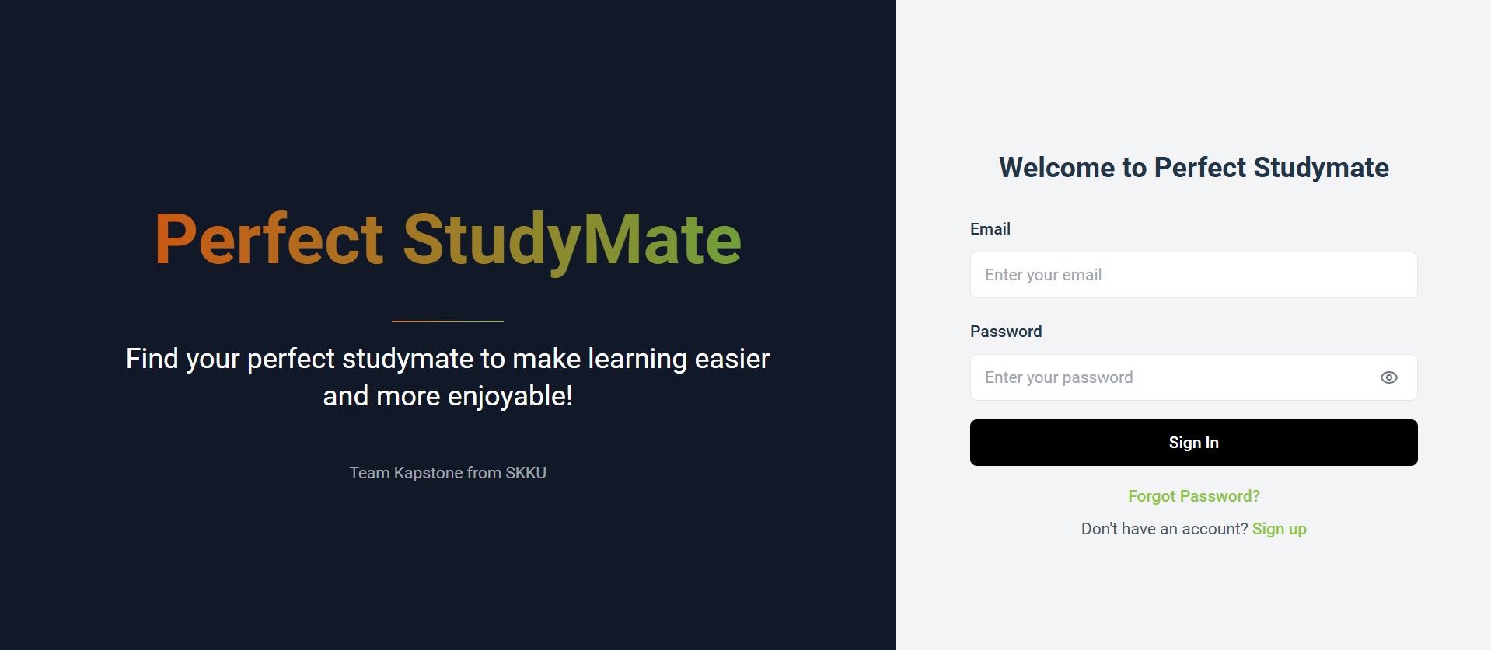
Frontend Development
Bug Fixes & Improvements
1. Implemented better design on landing page and developed it to be responsive

Slide 8
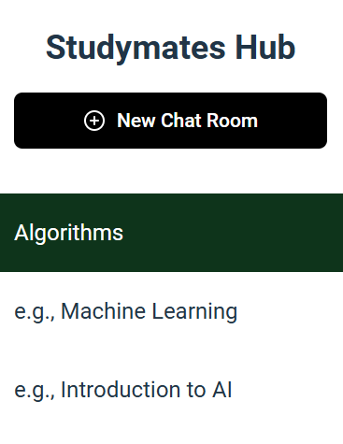

Frontend Development
Bug Fixes & Improvements
2. Fixed bug that attached files were all shared in every chatrooms.
→ so that each chat window can generate a response specific to the uploaded files.
3. When a new chatroom is created, it opens immediately.
4. New chatroom is added at the top of the chat sidebar.

Slide 9
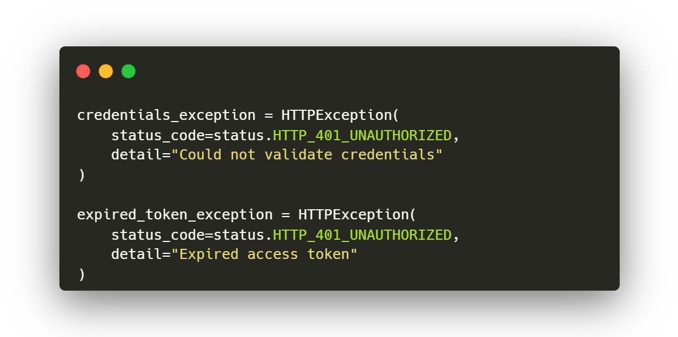
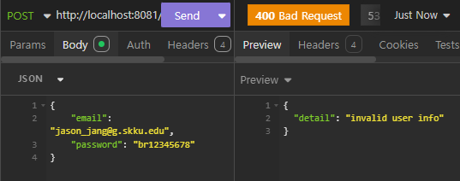
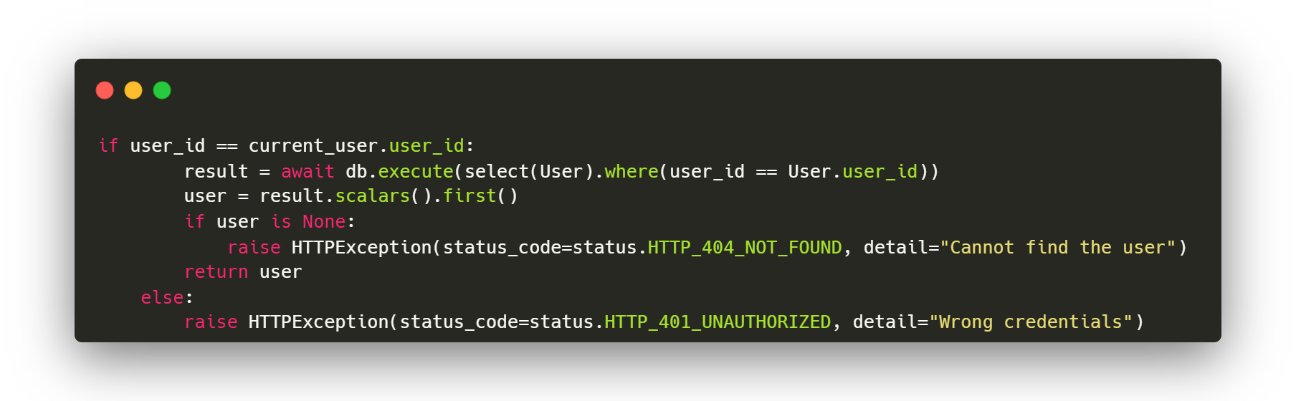
Backend Development
Exception Handling | Trying to Search Potential Errors
Notes:
Backend functionalities are almost done, and we’re working on exception handling like constraints for user registration, login, and token expiration.

Slide 10
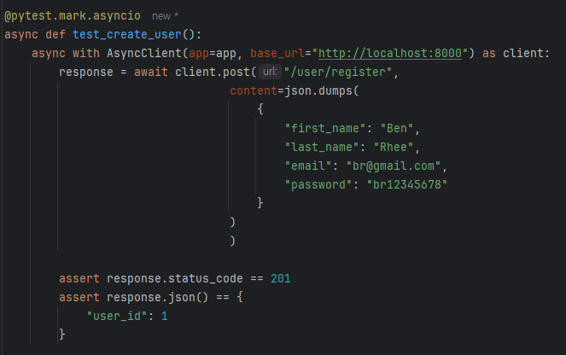

Backend Development
Integration Handling | Using Pytest
Pytest
Pytest is a mature full-featured
Python testing tool
that helps to write better programs.
Test implemented API by using Pytest
Notes:
And, Backend started testing each api through testing framework pytest.

Slide 11


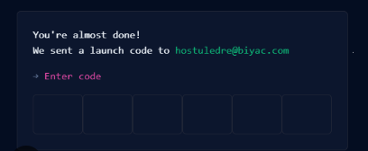

Backend Development
Email Configuration
We’re planning to put email configuration to prevent limitless registration.
Notes:
But since we’re using email to login and don’t want people to access through random email, so we’re also trying to implement email confirmation by using fastapi-mail library. The user will be able to access after typing exact code that’s in the mail

Slide 12
AI Development
Integration between Backend and RAG
Objective
Store and access
User and system chat history
Vector
Database
S3
Storage
Corretly access each user’s
Course materials
AI
Backend
Interface
Make AI function calls

Slide 13
AI Development
AI Architecture Development : two main classes
contains methods for initialization of the model,
connection to needed computational resources and methods for answering questions.
chatbot
manages the embedding vectors stored in the ChromaDB, giving the ability to add,
modify and delete embedded documents.
Corpus
Manager

Slide 14
AI Development
AI Architecture Improvements | Quiz Generator models
Exploring the idea of fine-tuning LLM model specifically for generating quizzes based on course material
Access an external database
to generate a response
Adjust formality,
such as
tone of the response
Fine-Tuned
LLM Model
RAG
Improve the accuracy
of responses

Slide 15

AI Development
AI Architecture Improvements | Model Evaluation
RAGAS
Ragas is a library that provides tools to evaluate LLM based applications.
Synthetic test dataset
Generated by Langchain
Sample questions
Ground truths
of sample questions
Test dataset
Generated by human
Evaluation
using RAGAS
Notes:
Ragas is a library that provides tools to evaluate LLM based applications. To test chatbot using RAGAS, we need some sample datasets. There are two kinds of datasets : synthetic test dataset generated automatically by langchain and test dataset generated by human in hand! In this project, we’re trying both kinds of test datasets to evaluate models more objectively. By using these datasets, we can evaluate our model with various metrics.

Slide 16
AI Development
AI Architecture Improvements | Model Evaluation
Context Recall
Context Precision
It measures how much the searched context
matches the answers generated by LLM.
It evaluates whether ground-truth related items within contexts are ranked high.
Answer Relevancy
Faithfulness
It measures how appropriate a generated answer is to a given prompt. It reflects the relevance of the generated response, the degree of redundancy, etc. in the assessment.
It measures the factual consistency of the generated answers against a given context.
Coming soon…
Notes:
There are four main metrics that we can evaluate our model in RAGAS. ~ ~ ~ ~. We will conduct the evaluation by tuning our model and changing several parameters.

